Slide 1
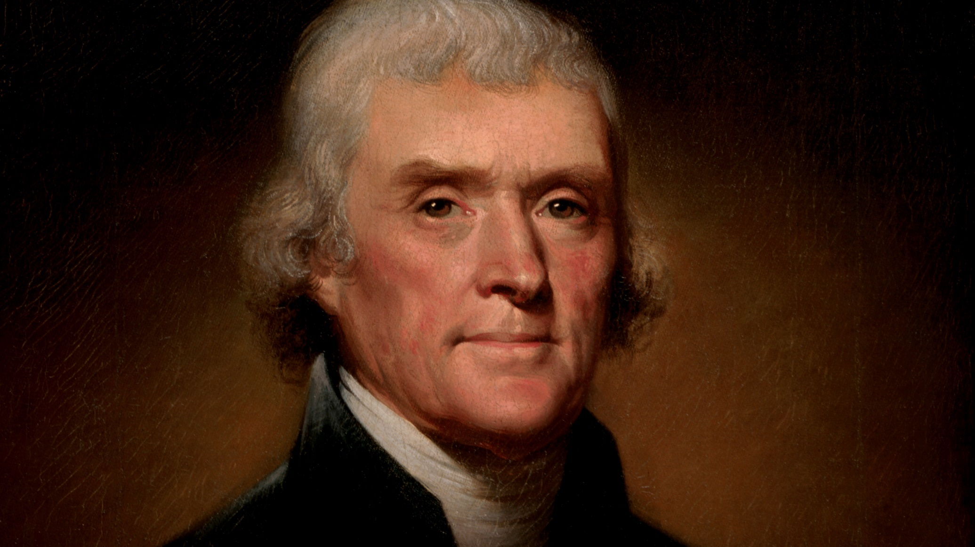
Bigram – Let us
Trigram – Whole constitutional vigor
“Equal and exact justice to all men, of whatever state or persuasion, religious or political… the preservation of the General Government in its whole constitutional vigor, as the sheet anchor of our peace at home and safety abroad.”
Thomas Jefferson

Slide 2
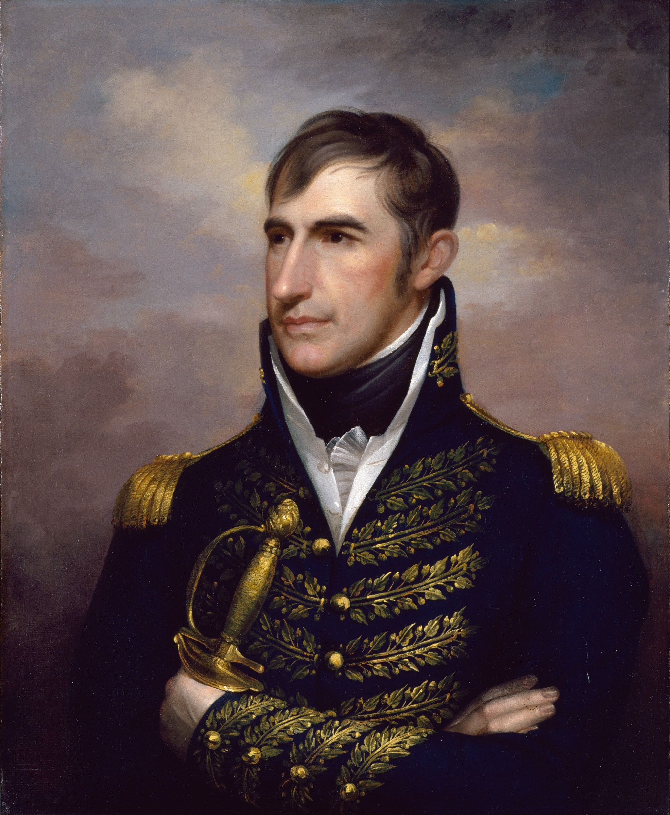
Bigram – American citizens
Trigram – Exclusive metal currency
“If there is one measure … by which the rich are daily adding to their hoards and the poor sinking deeper into penury, it is an exclusive metallic currency. Or if there is a process by which the character of the country for generosity and nobleness of feeling may be destroyed … it is an exclusive metallic currency.”
William Henry Harrison

Slide 3
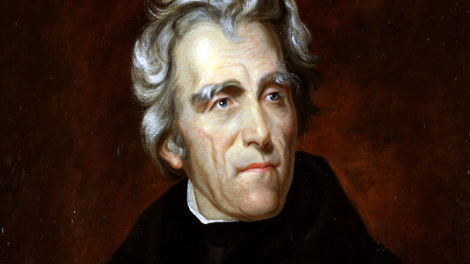
Bigram – General government
Trigram – Indian tribe within
“It will be my sincere and constant desire to observe toward the Indian tribes within our limits a just and liberal policy, and to give that humane and considerate attention to their rights and their wants which is consistent with the habits of our Government and the feelings of our people.”
Andrew Jackson

Slide 4
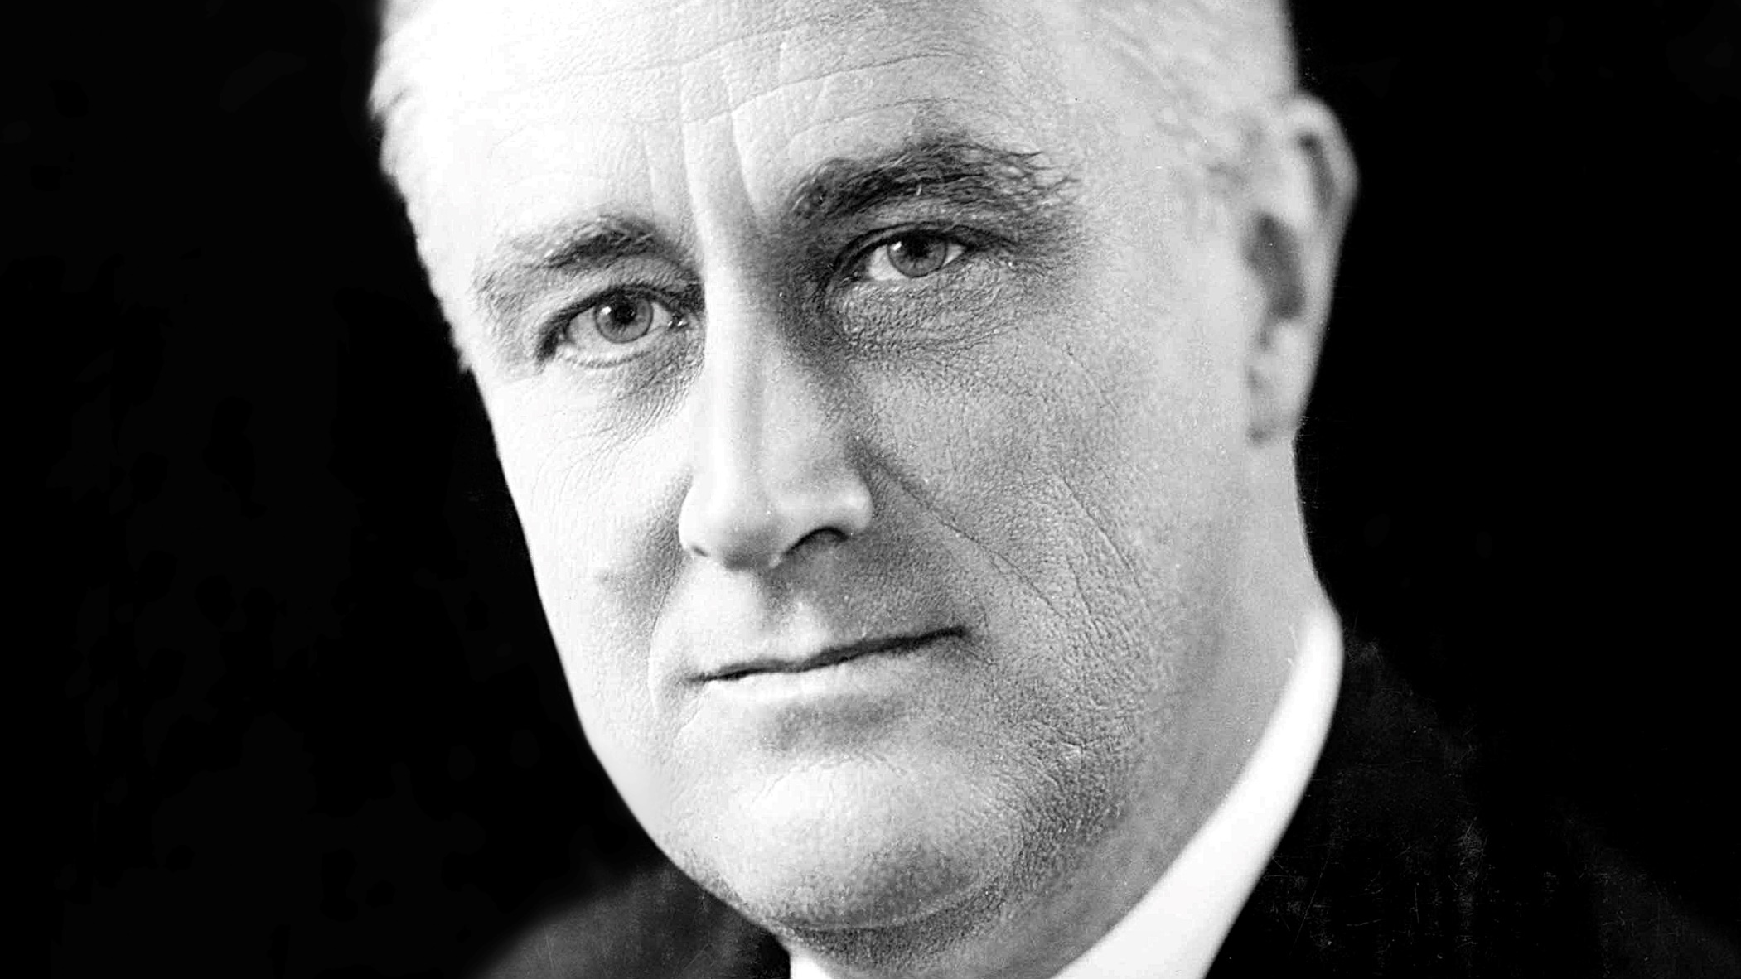
Bigram – Nation life
Trigram – Great nation will
“This great Nation will endure as it has endured, will revive and will prosper. So, first of all, let me assert my firm belief that the only thing we have to fear is fear itself—nameless, unreasoning, unjustified terror which paralyzes needed efforts to convert retreat into advance. In every dark hour of our national life a leadership of frankness and vigor … is essential to victory.”
Franklin Delano Roosevelt

Slide 5
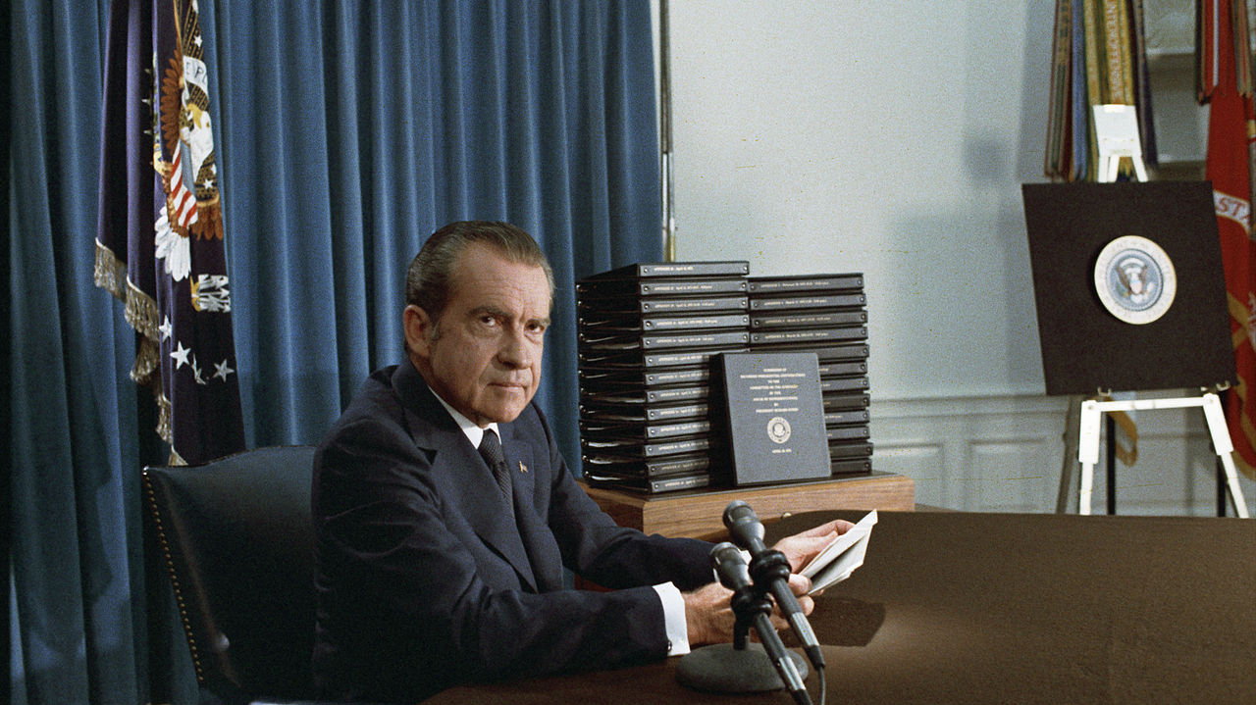
Bigram – Let us
Trigram – Go forward together
“No man can be fully free while his neighbor is not. To go forward at all is to go forward together. This means black and white together, as one nation, not two. ”
“Let all nations know that during this administration our lines of communication will be open.”
Richard Nixon

Slide 6
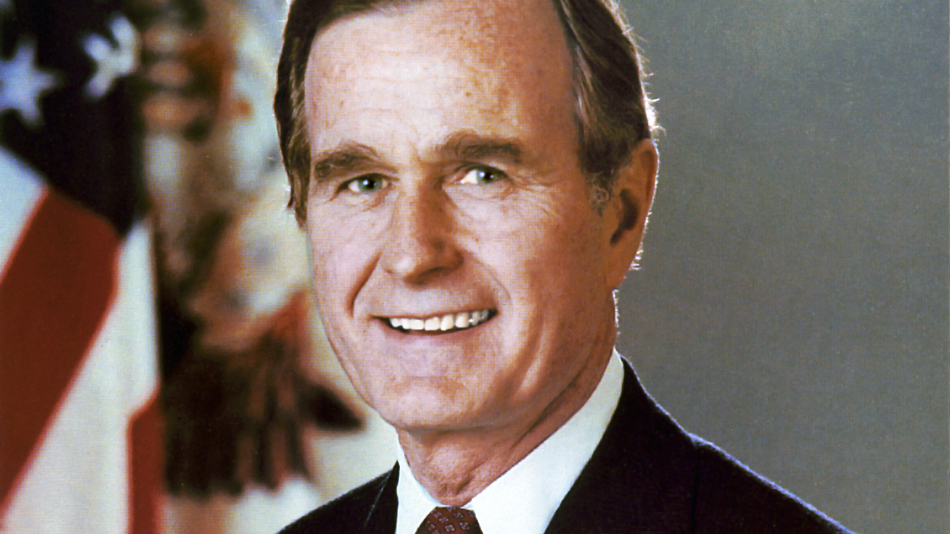
Bigram – Great nation
Trigram – Crucial things unity
“In crucial things, unity; in important things, diversity; in all things, generosity…. They didn't send us here to bicker. They ask us to rise above the merely partisan. "In crucial things, unity"--and this, my friends, is crucial.”
George H.W. Bush

Slide 7
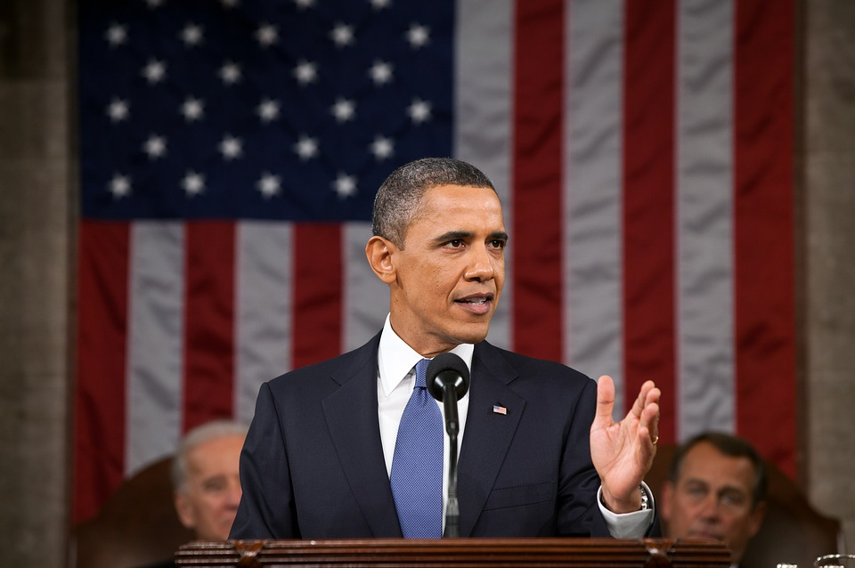
Bigram – Let us
Trigram – People still believe
“We, the people, still believe that every citizen deserves a basic measure of security and dignity.”
“Let us, each of us, now embrace with solemn duty and awesome joy what is our lasting birthright. With common effort and common purpose, with passion and dedication, let us answer the call of history...”
Barack Obama

Slide 8
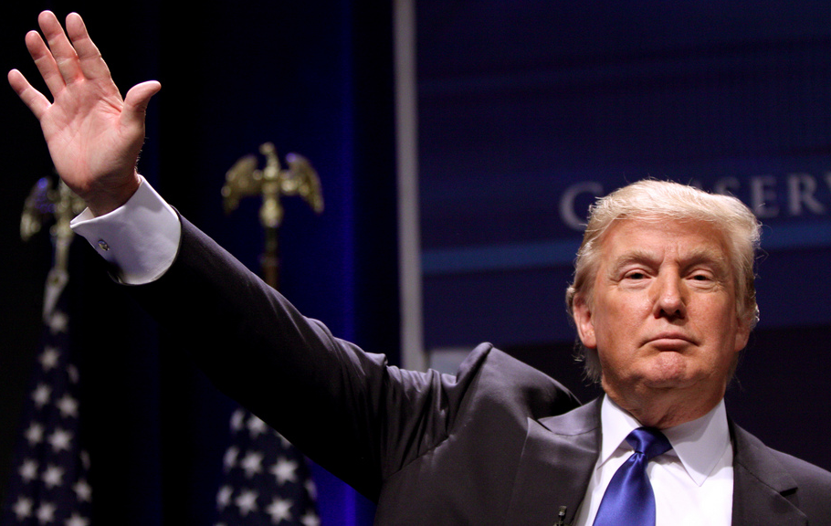
Bigram – Make America
Trigram – Make America great
“Together, We Will Make America Strong Again.
We Will Make America Wealthy Again.
We Will Make America Proud Again.
We Will Make America Safe Again.
And, Yes, Together, We Will Make America Great Again.”
Donald Trump

